Slide 1
Unit 16:
The AIX Graphical User Interface

Slide 2
Unit Objectives
After completing this unit, you should be able to:
List the advantages of the AIXwindows environment
Explain the AIXwindows client/server model
Start AIXwindows and initiate X Clients
Display remote clients on your system
Introduce the Common Desktop Environment (CDE)
Describe commonly used CDE components

Slide 3
The X Window System
Network-based graphics subsystem
Developed at MIT in 1984 (Project Athena)
Designed initially for UNIX-based systems
Important design aspects
  Used client/server model
  Network aware (works over TCP/IP)
  Protocol is independent of operating system and graphics device
AIX 6.1 includes X11R7.1
  Backwards compatible with all prior releases
IBM’s port of the X Window System is called “AIXwindows”
Notes:
Notes:
Instructor notes:
Purpose —
Details —
Additional information —
Transition statement —

Slide 4
What is AIXwindows?
AIXwindows is IBM's enhancement to the X Window system and Motif
The windows enable you to work with multiple items simultaneously
Provides window functions such as: opening, sizing, and moving
Provides the capability to manage local and remote displays

Slide 5
An X Window System Network Configuration
Networked workstations and file servers
Heterogeneous environment
A client/server environment
Xstation
RISC workstation
IBM System p
workstation
Intel PC
IBM System p
Workstation
IBM System p server

Slide 6
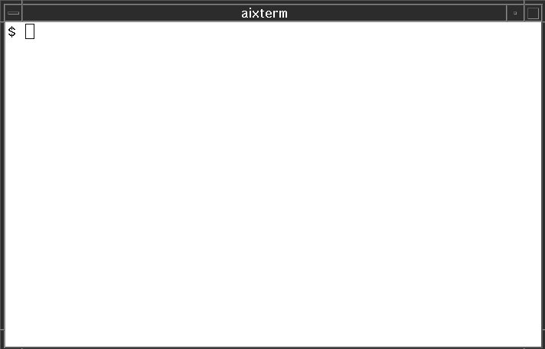
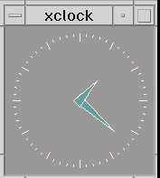
The Client/Server Environment
(System A)
(System B)

Slide 7
X Clients
X Clients are the applications which the user runs under the X window system:
Examples: aixterm, xterm, xclock, xcalc, xwd, mwm
X Clients can be started from the command line or from special startup files
Most X clients share the same options:
-bg color
Color for the window background
-bd color
Color for the window border
-bw number
Width in pixel of the window border
-display hostname:number
Identifies host server name and X Server display number
-fg color
Color for the window foreground
-fn font
Normal sized text fontset

Slide 8
The X Server
Each X Server:
  Controls one keyboard, one mouse, and one or more screens
  Allows simultaneous access by several clients
  Performs basic graphic operations
  Provides information such as fonts and colors
  Routes keyboard and mouse input to the correct clients

Slide 9
Starting X
$ startx
  - Starts the X server, Motif Window manager (mwm), and the aixterm and xclock clients

Slide 10
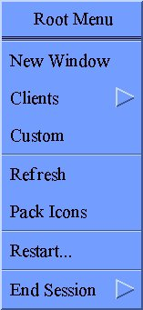
Stopping X
IBM
Click the desktop background (known as the root window) with the right mouse button.
Select End Session.
If the X server will not exit, use <Ctrl><Alt><Bksp>
Click on right
mouse button

Slide 11

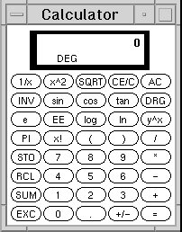

An AIXwindows Display
aixterm windows
xclock
IBM
iconified window
root window
xcalc

Slide 12
The aixterm Window
An aixterm can be started in two ways:
In a shell, by using the command aixterm &
Display the Root Menu and select New Window

Slide 13
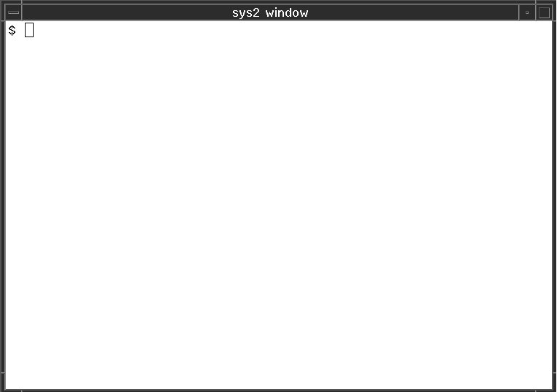
Running a Client on Another System
sys1
sys2
IBM
aixterm -display sys1:0
$ rexec sys2 aixterm -display sys1:0

Slide 14
The xhost Command
The xhost command adds and deletes hosts on the list of machines from which the X Server accepts connections:
  xhost [ + | - ] [ hostname ]
$ xhost + moon
$ xhost - pluto
$ xhost +
Allow moon to start X clients
Deny pluto to start X clients
Allow all hosts to start X clients

Slide 15
The xauth Command
The xauth command is used to display and edit the authorization information used in connecting to the X server.
Uses a cryptographic key (called a cookie)
Allows for per-user access control to the X server
Overrides the xhost mechanism.
hostA$ xauth list
hostA:0 MIT-MAGIC-COOKIE-1 566e6b7a786543387746464337396c67
hostA$ xauth extract xauthfile.txt hostA
hostA$ scp xauthfile.txt team02@hostB:xauthfile.txt
hostB$ xauth merge xauthfile.txt
hostB$ aixterm –display hostA:0 &

Slide 16
Common Desktop Environment (CDE)
X11/Motif
HP's VUE
IBM's CUA
and
Workplace Shell
CDE
USL's Desktop
Manager
and scalable
systems
technology
SunSoft's:
OPEN LOOK elements
DeskSet productivity tools
ToolTalk messaging system

Slide 17
The Components of the CDE Desktop
The Login Manager
The Front Panel
The Style Manager
The File Manager
The Application Manager
Personal Applications
The Help Manager

Slide 18
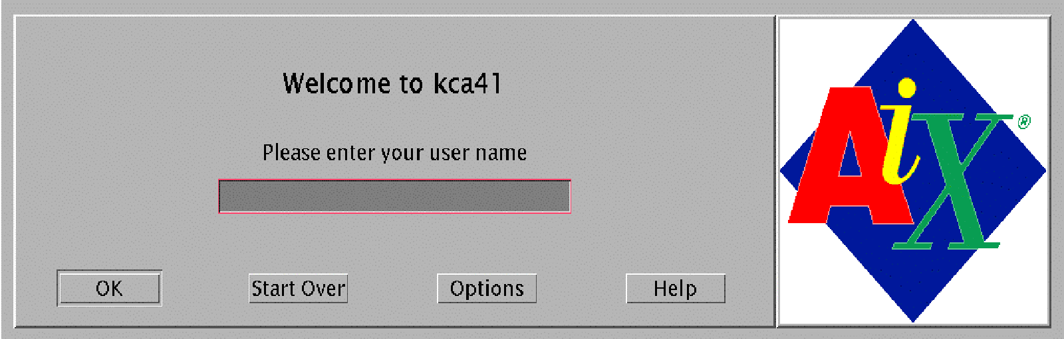
The Login Manager

Slide 19
$HOME/.dtprofile
Sets environment variables when using CDE
By default, .profile will be ignored
To force a read of .profile, uncomment last line of .dtprofile to read:
$ vi $HOME/.dtprofile
...
DTSOURCEPROFILE=true
:wq

Slide 20
Front Panel
Personal Applications Subpanel
Style Manager
File Manager
Help
Trash
Workspace Switch
Calendar
Mailer
Printer
Application Manager

Slide 21
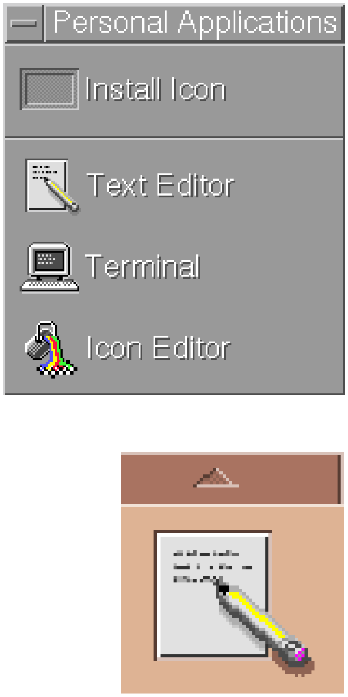
Front Panel - Subpanels
Subpanel
Install Icon Area
Subpanel
Controls
Subpanel
access
area

Slide 22
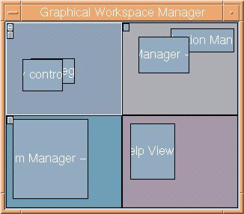

Front Panel - Further Controls
One
Two
Three
Four
Workspace Switch
Lock
Busy
Graphical Workspace Manager
Exit

Slide 23
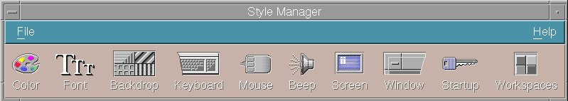
The Style Manager
The Style Manager allows interactive customization of the desktop environment.

Slide 24
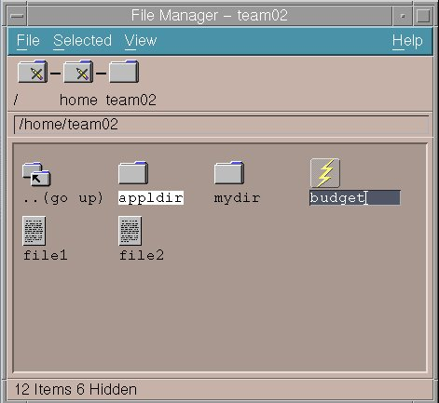
The File Manager
Navigate file system
Work with files and directories
Drag and drop actions
Launch applications

Slide 25
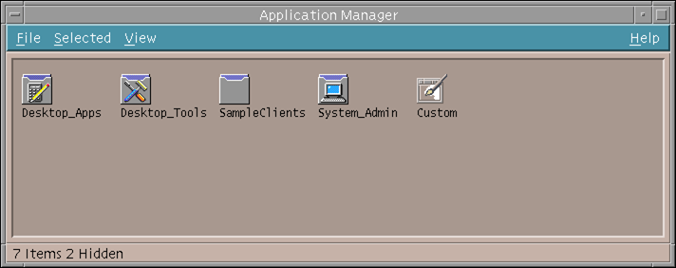
The Application Manager

Slide 26
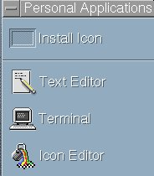
The Personal Applications Manager
Personal Application Subpanel

Slide 27
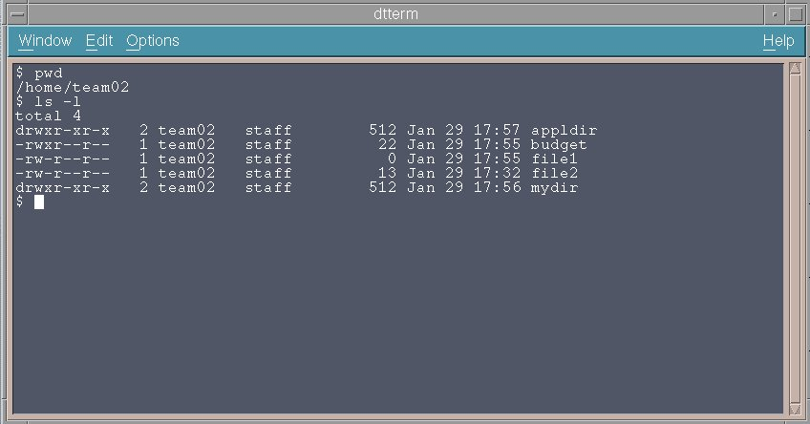
The Terminal Emulator

Slide 28
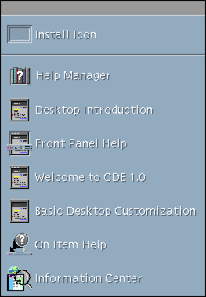


The Help System
Readily available from:
Help Key
Application Help Menu
Help Subpanel

Slide 29
Checkpoint (1 of 2)
If running AIXwindows, what would the following command do? xclock -bg red -fg white &
List two ways to start a new aixterm.
Assume two systems: nysys (in New York) and dalsys (in Dallas). What would be the result if the following command were issued from the AIXwindows environment on dalsys? rexec nysys xclock -d dalsys:0
What is an easy way to customize your AIXwindows environment?

Slide 30
Checkpoint Solutions (1 of 2)
If running AIXwindows, what would the following command do? xclock -bg red -fg white &
  This command would start an analog clock with a red background and white foreground.
List two ways to start a new aixterm.
  Choose New Window from the root menu.
  Execute the aixterm command in the background.
Assume two systems: nysys (in New York) and dalsys (in Dallas). What would be the result if the following command were issued from the AIXwindows environment on dalsys? rexec nysys xclock -d dalsys:0
  This would display an xclock from nysys on dalsys.
What is an easy way to customize your AIXwindows environment?
  From the root window, choose custom. This will customize flat files in your home directory for your AIXwindows environment. This will be further discussed in the next unit.

Slide 31
Checkpoint (2 of 2)
True or false? CDE is designed as a common user interface for the UNIX environment.
Match the following terms with their correct meanings:
  Login Manager __ Can be used to obtain a dtterm
  Front Panel __ Can be used to work with online
  documentation
  Personal Applications __ Used to customize CDE
  File Manager __ The application "Launcher"
  Application Manager __ Maintains desktop look between
  sessions
  Style Manager __ Provides a GUI to work with files
  Session Manager __ Used to manage applications
  Help Manager __ Authenticates the user ID
True or false? Any environment variables set in .profile will be used by default in the CDE environment.

Slide 32
Checkpoint Solutions (2 of 2)
True or false? CDE is designed as a common user interface for the UNIX environment. True.
Match the following terms with their correct meanings:
  Login Manager c Can be used to obtain a dtterm
  Front Panel h Can be used to work with online
  documentation
  Personal Applications f Used to customize CDE
  File Manager b The application "Launcher"
  Application Manager g Maintains desktop look between sessions
  Style Manager d Provides a GUI to work with files
  Session Manager e Used to manage applications
  Help Manager a Authenticates the user ID
True or false? Any environment variables set in .profile will be used by default in the CDE environment. False. In order for CDE to read .profile, the last line of .dtprofile must be uncommented.

Slide 33

Exercise: Using AIXwindows and CDE

Slide 34
Unit Summary
AIXwindows is AIX's windowing system. It includes X Windows, Motif, and CDE.
The X Client is the application that displays the graphics while the X Server controls the display screen and input.
Start AIXwindows using the startx command.
Use the DISPLAY variable or the -display option to designate which server a client will send its output to.
The CDE provides a common user interface for the user environment.

